Slide 1
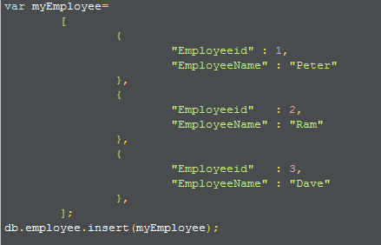
Add MongoDB Array using insert() with Example
The "insert" command can also be used to insert multiple documents into a collection at one time.
Create a JavaScript variable called myEmployee to hold the array of documents and add the required documents with the Field Name and values to the variable and use the insert command to insert the array of documents into the collection
https://www.guru99.com/add-mongodb-array-using-insert.html

Slide 2
Add MongoDB Array using insert() with Example
JSON is a format called JavaScript Object Notation, and is just a way to store information in an organized, easy-to-read manner.
We are using the JSON print functionality to see the output in a better format. printjson command to the forEach statement will cause each document in the collection to be displayed in JSON format.

